Slide 1
Objectives
In this session, you will learn to:
  Work with data manipulation objects

Slide 2
Using the Array Object
Arrays are variables used to store a sequence of values.
These values are stored in indexed locations within the array.

Slide 3
Using the Array Object (Contd.)
The following syntax is used for creating an Array object:
  var category = new Array(3)
For example:
  category[0] = "Soaps"
  category[1] = "Oils"
  category[2] = "Food Products"

Slide 4
Using the Array Object (Contd.)
The following syntax is used for accessing the first element in the array:
  category[0];
For example:
  <html>
  <body>
  <script type="text/javascript">
  var category = new Array(3)
  category[0] = "Soaps"
  category[1] = "Oils"
  category[2] = "Food Products"
  document.write(category[0]+"<br/>")
  document.write(category[1]+"<br/>")

Slide 5
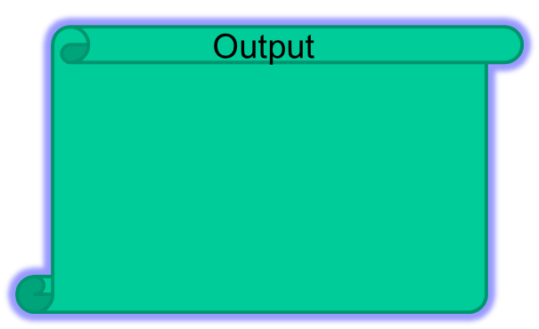

Using the Array Object (Contd.)
  document.write(category[2]+"<br/>")
  </script>
  </body>
  </html>

Slide 6
Using the Array Object (Contd.)
Values of an existing array can be modified by re-assigning a value to the array at the required index.
Consider the following code snippet to modify an element of the mixedArray at the 0 index:
  mixedArray[0]="Hunt"

Slide 7
Using the Array Object (Contd.)
The most commonly used properties of the Array object are listed in the following table.
Properties | Description | Example
Length | Returns the length of an array. | var alphabets=["A","B","C","D"] document.write(alphabets.length); displays 4

Slide 8


Using the Array Object (Contd.)
For example:
  <html>
  <body>
  <script type="text/javascript">
  var category = new Array("Soap","Oil")
  document.write("The length of the array is: "
  + category.length + "<BR>")
  </script>
  </body>
  </html>

Slide 9
Using the Array Object (Contd.)
The following table lists the most commonly used methods associated with the Array object.
Methods | Description | Example
concat() | Returns an array object as a combination of two array objects. | var number = ["1", "2"]; var number1 = ["3", "4"]; document.write(number.concat(number1) + "<br />"); displays 1,2,3,4
join(separator_String) | Joins the elements of an array into a string and returns it. The separator_String is optional. | var number = ["1", "2", "3", "4"]; document.write(number.join(:) + "<br />"); displays 1:2:3:4

Slide 10
Demo: Using Array Object
Problem Statement:
  David, the CEO of the company BookYourShow Inc. wants to provide a feature on the website that displays the movie details, such as movie name, show time, and show date for all the shows running on the current day in a section of the Web page. David has asked the Web designer to implement the functionality. Help the designer to successfully accomplish this task.

Slide 11
Demo: Using Array Object (Contd.)
Solution:
  To solve the preceding problem, you need to perform the following tasks:
    Create the user interface.
    Store the movie details in an array.
    Display the movie details.
    View the details page and verify the output.

Slide 12
Global Methods and Object Properties
There are certain methods and properties that are applicable to all the data manipulation objects of JavaScript.
These are known as global methods and properties.

Slide 13
Global Methods and Object Properties (Contd.)
The following table lists the most commonly used global properties.
Properties | Description | Example
Infinity | Represents positive or negative infinity value. | var x=4/0; document.write(x + "<br />"); var y=-4/0; document.write( y + "<br />"); results in Infinity -Infinity

Slide 14
Global Methods and Object Properties (Contd.)
The following table lists the most commonly used global methods.
Methods | Description | Example
parseFloat() | Returns a floating number after parsing a string. | document.write(parseFloat("15") + "<br />"); results in 15
parseInt() | Returns an integer after parsing a string. | document.write(parseInt("20"); results in 20

Slide 15
Global Methods and Object Properties (Contd.)
For example:
  <html>
  <head>
  <script type="text/javascript">
  function price()
  {
  item1=parseInt(itemPrice1.value);
  item2=parseInt(itemPrice2.value);
  totalPrice=item1+item2;
  alert("total price is $ "+totalPrice);
  }
  </script>
  </head>
  <body>

Slide 16
Global Methods and Object Properties (Contd.)
Enter price of item 1:
<input type="text" id="itemPrice1" />
<br/>
Enter price of item 2:
<input type="text" id="itemPrice2" />
<br/>
<br/>
<input type="button" value="calculate total price“
onclick="price()" />
</body>
</html>

Slide 17
Summary
In this session, you learned that:
  Arrays are variables used to store a sequence of values.

